Slide 1
C(ru)X50’s Introduction to Machine Learning

Slide 2
What is Machine Learning?
Artificial Intelligence
Machine Learning
Deep Learning
Artificial Intelligence: Programs that are able to simulate human thought processes.
Machine Learning: Subset of artificial intelligence algorithms that learn without being explicitly programmed
Deep learning: Subset of machine learning that uses neural networks to solve complex problems such as image recognition and natural language processing

Slide 3
Types of Machine Learning
Supervised Learning
Labelled Data
Unsupervised Learning
Unlabelled Data
Semi-supervised Learning
Partly labelled data
Clustering
Grouping data based on similarity
Association
Finding relationships between variables
Classification
Discrete target variable
Regression
Continuous target variable
Reinforcement Learning
Learning through exploration and subsequent rewards
eg. Finding tumors in medical imagery
eg. Estimating the price of a concert ticket
eg. Grouping pictures of faces that are similar to each other
eg. Finding the products a person who buys bread is likely to buy (jam, butter etc)

Slide 4
Finding Data to Learn From: What Is a Dataset?
Simply put, a dataset is a collection of data.
Some forms the data can take:
Attributes/features that together create a datapoint
Images
Audio
Most datasets tend to be “unclean” – in need of pre-processing before learning can take place
Analysing a dataset is always the first step in building any ML model

Slide 5
Libraries Used For Data Analysis & Processing
Pandas: Allows one to organize data into tabular dataframes, read data from .csv and .xlsx files among others.
Matplotlib: Plotting library in python that allows one to visualize graphs and images.
NumPy: Used to work with complex multidimensional arrays and perform complex mathematical functions on them.
OpenCV: Provides functions used to clean up image data.

Slide 6
Python Libraries Used to Build ML Models
Scikit-Learn: Machine learning library that includes a bunch of classification, regression and clustering models
Tensorflow: Open source software library primarily used to train neural networks, developed by google.
Keras: Open source high-level machine learning library, capable of running on top of Tensorflow.
PyTorch: Machine learning framework used to build neural networks, developed by Meta and Linux Foundation.
OpenCV: Library primarily used for Computer Vision tasks, developed by Intel.

Slide 7
Basic Steps To Solve An ML Problem
Acquiring high-quality data
Visualising and getting familiar with the data
Preprocessing the data
Splitting data into training set, testing set and optionally, validation set
Initializing and building an ML model
Training the model against training data and tracking improvement against the validation set
Testing the model against the testing set

Slide 8
Learning With Examples:
Predicting the sub-species of an Iris flower sample using the k-Nearest Neighbours algorithm (Supervised Classification problem) – Iris Dataset
Clustering together samples belonging to the same sub-species of Iris flowers using the K-means clustering algorithm (Unsupervised Clustering problem) – Iris Dataset
Identifying handwritten numerical digits using an Artificial Neural Network (Supervised Computer Vision – Image recognition problem) – MNIST Dataset

Slide 9
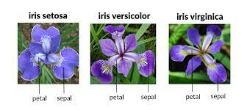
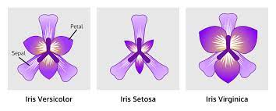
About the Dataset: The Iris Flowers Dataset
Contains 150 datapoints – 50 samples from each of 3 species of the Iris flowering plant genus – Setosa, Versicolor, Virginica
Each datapoint has 4 features – sepal length, sepal width, petal length and petal width, along with the target variable, i.e., index of its species
Our tasks:
Accurately classify datapoints into one of the 3 species
Cluster datapoints of the same species together, best as possible

Slide 10
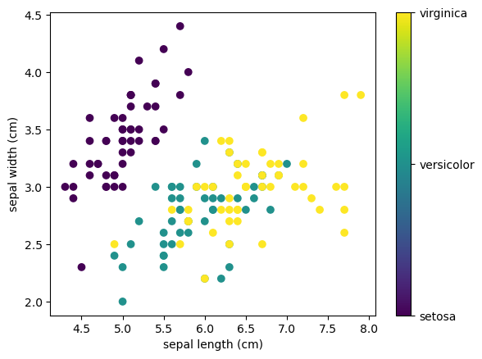
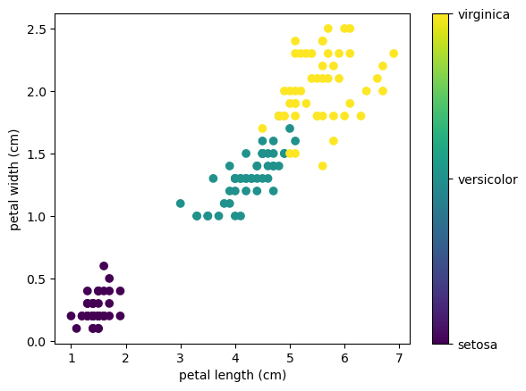
Visualizing the data
Visualising each datapoint in its 4-dimensional space is impossible
However, we can visualise 2 attributes at a time on a 2-D cartesian plane using matplotlib’s scatterplot
In the sepal width vs sepal length scatterplot, we can see a clear cluster of the setosa datapoints, while the other two classes seem to be scatter amongst each other
Distinction between classes becomes clearer when we plot petal width vs petal length

Slide 11
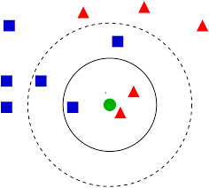
Task 1: Classification
Algorithm used: K-Nearest Neighbours Classification
One of the simplest ML algorithms, it uses a distance metric to classify a datapoint, given proximity to other datapoints
It classifies a datapoint to the same class as that of the majority class of its k nearest neighbours
k=3
k=5

Slide 12
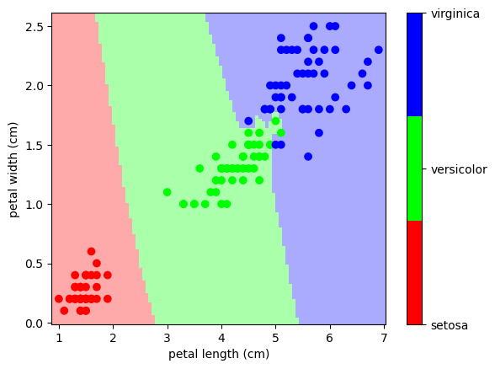
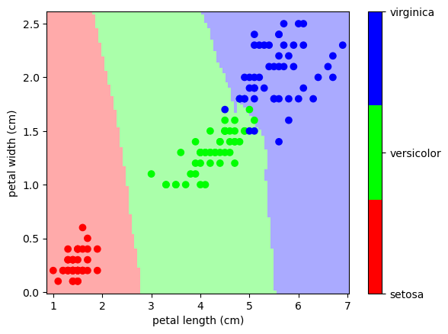
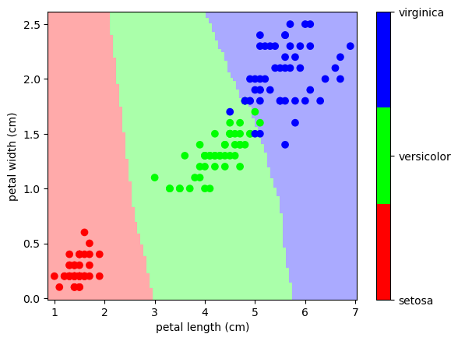

Decision boundaries for different values of K
K=1
K=5
K=10
K=20

Slide 13
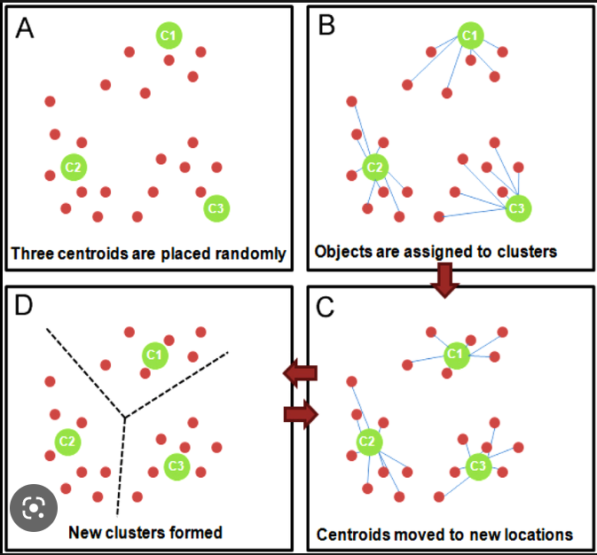
Task 2: Clustering
The K-Means clustering algorithm is used to cluster data into K different groups
It does so by randomly placing K centroids in the beginning, and then iteratively calculating the variance before moving the centroid to a new position in order to minimise the variance
Then, it reassigns points to the new centroids. This process continues until no new reassignments occur or the model hits a predefined number of iterations to run

Slide 14
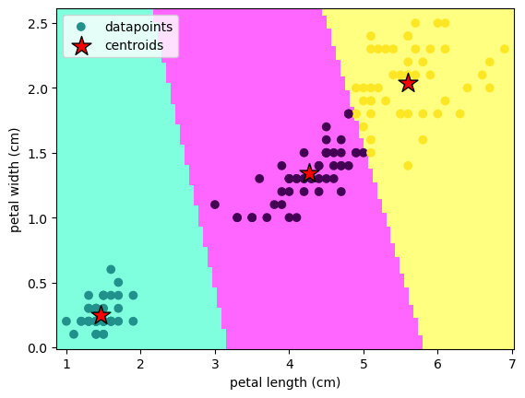
Decision Boundaries Made by the Clusterer

Slide 15
A Brief Introduction To Deep Learning
INPUT
HIDDEN
OUTPUT
A neural network is an artificial simulation of a brain and its neurons
It consists of nodes, or “neurons”, and weights or edges that connect nodes of one layer to nodes of the next layer
Each node has a value associated with it
The value is calculated by summing up all the values of the nodes of the previous layer multiplied by the weight connecting them to the new node
The value is also added to another value called a “bias” and is passed through an “activation function”, for example, RELU, that returns the number itself if the number is positive or 0 if it is negative.
0.1
0.3
0.27
0.6
0.8
0.3
0.33
0.9

Slide 16
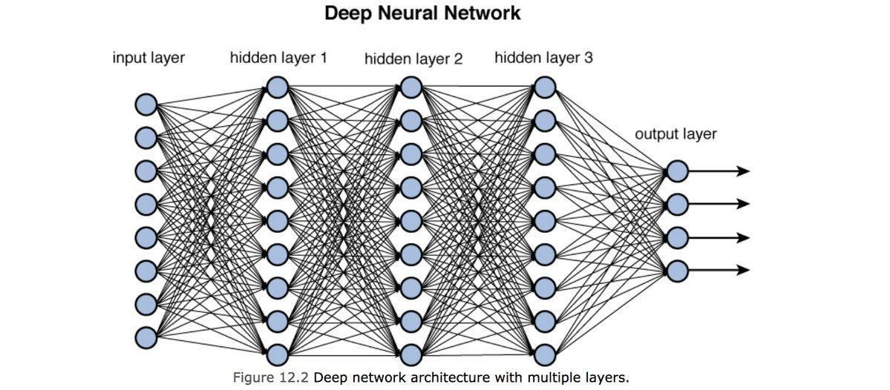
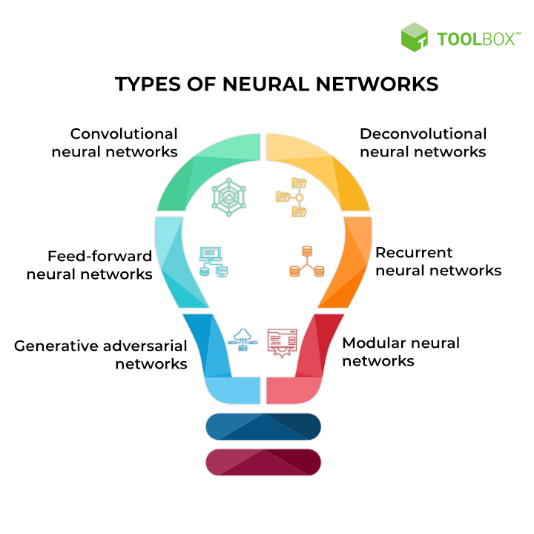
In reality, most neural networks have multiple hidden layers, comprised of many thousands of nodes
A neural network uses the above calculations to “feed-forward” input values and generate output values
It trains itself by feeding backward the loss between its predicted and actual output value in a process called “backpropagation” (further learning: 3Blue1Brown vids)
Multiple types of neural networks exist suited to different tasks. For example, Convolutional NNs for computer vision, Recurrent NNs for NLP, Generative Adversial Networks for image generation tasks etc.

Slide 17
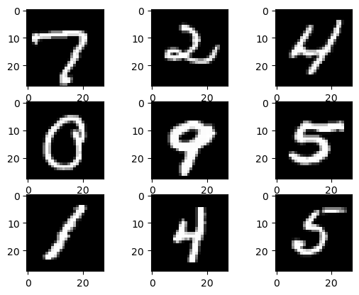
About the Dataset: the MNIST Database
Stands for Modified National Institute of Standards and Technology database
Collection of 60000 training + 10000 testing 28x28 grayscale images of handwritten digits from 0-9

Slide 18
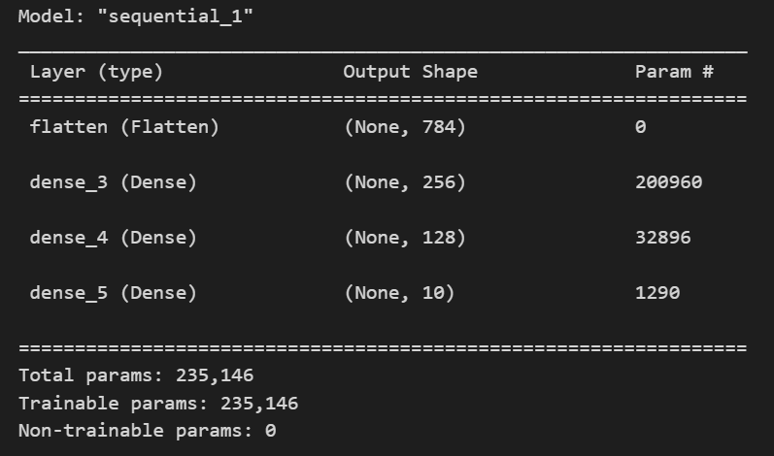
Creating the Neural Network
Using tensorflow, create a simple 2-dense layer deep network
Compile the network, specifying optimiser and loss function used
Fit the network to the training data
Test the network against testing data
INPUT (28x28)
Dense (256)
Dense (128)
Flatten
OUTPUT (10)

Slide 19
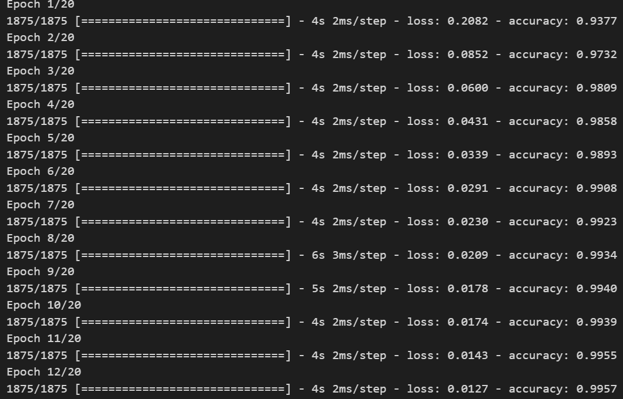
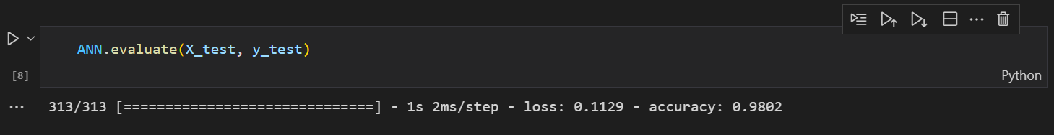
Training and Testing the Network
Upon training the network for 20 epochs (12 seen here), we see that the accuracy on the training dataset converges fairly rapidly to over 99.5% and beyond, reaching 99.68% by the end of fitting
The testing accuracy comes out to be about 98%

Slide 20
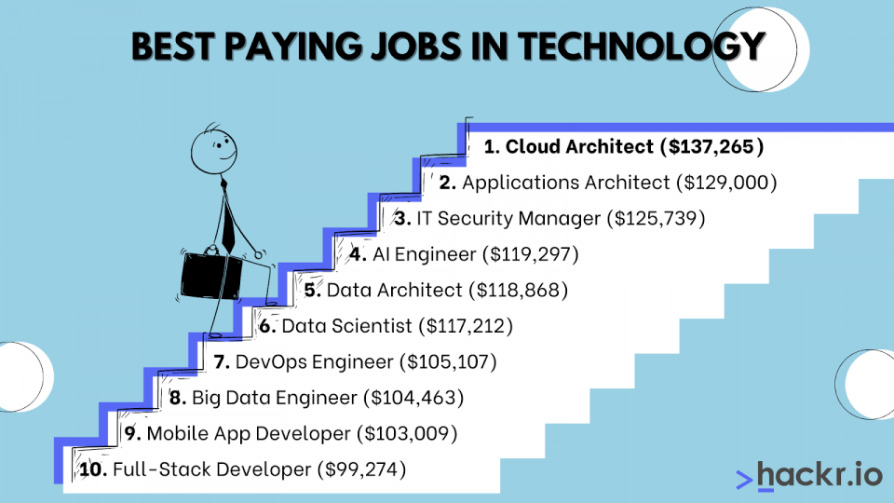
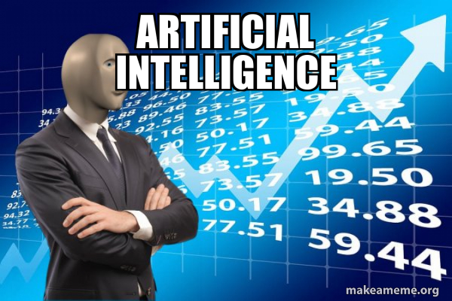

Why should you get into AI/ML?

Slide 21
Resources
https://github.com/adityapentyala/CRUx-intro-to-dev-ML-src
https://en.wikipedia.org/wiki/Artificial_neural_network
https://en.wikipedia.org/wiki/Computer_vision
https://www.youtube.com/playlist?list=PLZHQObOWTQDNU6R1_67000Dx_ZCJB-3pi

